Slide 1

Software architecture Assignment 2 Smart home system architecture
A system that handles IOT sensor events and execute routines for Lighting, whether control, Gate/Door Control and Security Systems for a home
Akhil Sudhakaran - 2021MT12054
2021mt12054@wilp.bits-pilani.ac.in

Slide 2
Goals of the smart home system
A smart home system manages day to day tasks such as lighting, whether control, gas supply control and gate/door management in a home.
A user can set instructions for smart systems (in response to events recorded by sensors) via a mobile application by connecting through a cloud hosted application or directly to a hub in the local home network.
The hub makes sure that the systems that it interacts with trigger actions based on the Sensor events it receives. The hub and the systems also make sure that the default behavior is followed when no events are recorded.
In case of drastic events such as gas leakage or gate stuck in the middle of closure, the hub notifies the user through the cloud service (or via the local network if the phone is in the local network) of such an event so that action can be taken
The hub also can listen to instructions given by smart speaker devices such as Alexa and Google home.

Slide 3
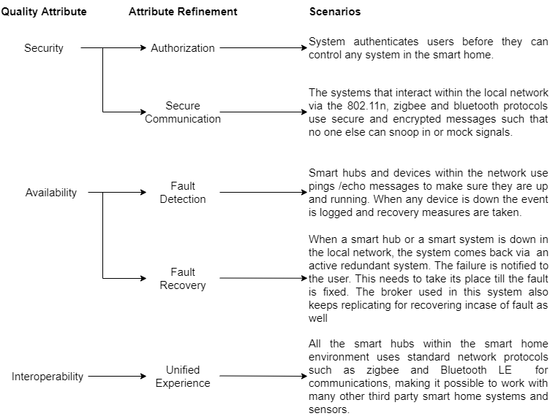
Utility tree of the top 3 ASRs for smart home systems

Slide 4
Tactics to achieve Top 3 ASRs
Quality Attribute | Scenario (Attribute Refinement) | Tactics
Security | Only authorized users can interact with the smart home system. Role based permissions need to be supported as well. | The hosted cloud application and the hub (for direct local access) will handle requests to the smart home environment after authenticating with SSO (Single Sign On). Other measures such as two factor authentication can also be used. This can be done by integrating to OAuth providers such as google. The application can have Users be put into guest roles and other groups which further helps in segregating the kind of interactions that can be executed in the smart home.
 | The systems within the smart home network should use encryption supported low energy based wireless protocols to make sure the communication channels are secure | Any communication between smart systems must be encrypted with the network key or other tokens created while authenticating the user. We can add new devices to the smart home environment by securely pairing these devices based on device identifier during setup to avoid a malicious device to interact with the environment

Slide 5
Tactics to achieve Top 3 ASRs (Cont.)
Quality Attribute | Scenario (Attribute Refinement) | Tactics
Availability | Detect faults with any systems in the smart home environment. | The smart hub checks for the availability of the systems by employing ping/echo messages. When there is a failure in response after a fixed number of retries then fault recovery can be triggered (This can be done activating the backup redundant system). The hub can also notify the user of failures in the system. The hosted application should scale up on demand and not fail due to faults related to high traffic.
 | Recover faults when it is detected in any system or hub within the smart home system | When the master hub fails, then we can employ active redundancy, where a new hub can come up soon and resume operations and notify the user of the failure. The broker used for communication should also be replicated, so that on a failure scenario The application hosted would also need to employ redundancy to make sure cloud services are highly available and use deployment strategies which aid in scaling up on demand
Interoperability | The system interfaces and works with existing popular smart home systems that use standard protocols for communication. | The hub that maintains the smart home network must support popular smart home communication protocols such as ZigBee, Bluetooth LE or Z wave.

Slide 6
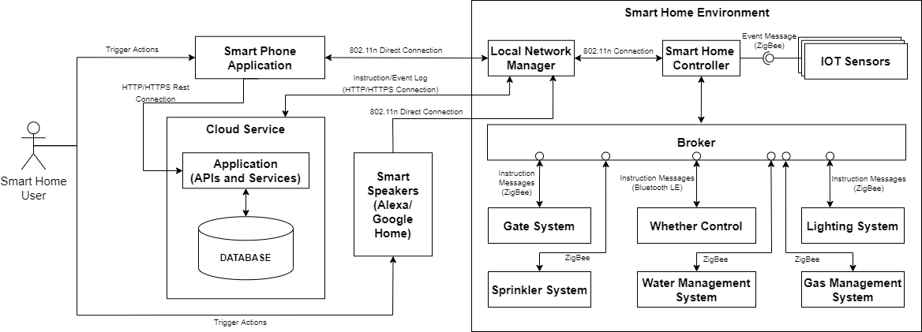
Component Connector Diagram
The following are the interactions that are seen between the major components in the system:
The smart phone application can either send instructions via the cloud hosted services from a remote network or even send them in the local network through Wi-Fi.
The user can also use smart speakers such as Alexa or Google home to give instructions to the hub via wifi network.
The IOT sensors, and other smart systems use standard low energy communication protocols such as ZigBee or Bluetooth LE. The Gate system, whether control and other systems communicate with the smart home hub through messages sent via a broker.

Slide 7
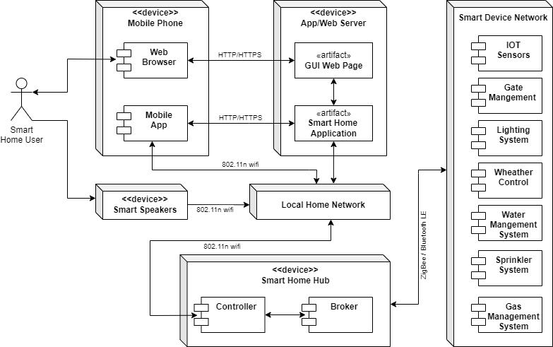
Deployment Diagram

Slide 8
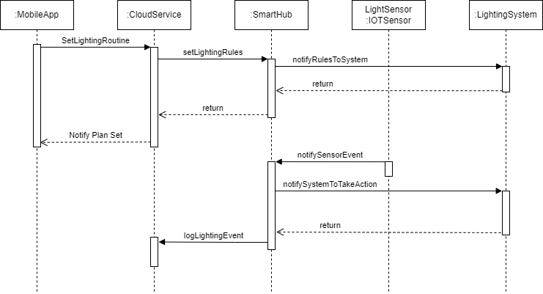
Sequence Diagram For Lighting System Management By a smart home System
The sequence diagram to the right shows the use case of how rules are set for the lighting system’s behavior and how these rules are enforced by the smart hub based on events recorded by the IOT Sensor.
The authenticated user uses the app to set how the lighting should behave based on the signals given by the IOT sensor events (such as darkness level, or presence of a person etc.)
The app sends these rules to the smart hub via the hosted application. The Hub lets the lighting system know about the change in it’s expected behavior.
When the optical IOT sensor sees an event, it notifies it to the smart hub. The hub then notifies the system to take the action based on this event.
The system does the necessary job and notifies the hub which in turn logs the event in the hosted application

Slide 9
Architectural Patterns used
The following are the architectural patterns used in designing the Smart Home system:
Broker Pattern: This pattern is used in the smart home environment where a broker (highly available and replicating) handles the message delivery between the hubs and other smart systems (This is seen in the Component and Connector diagram shown earlier here). The broker helps in getting decoupled components within a smart home to work together cohesively. This further helps in easing the interfacing of a new device later on.
Client Server: This pattern is used in the cloud hosted application which handles the requests by many smart home users. The Server would act as a bridge between the mobile app and the respective home’s smart hub. The application should be capable of scaling up when the requests it receives increases.

Slide 10
Key Learnings
Highly available systems are necessary for smart homes. Smart systems can save a home from a disaster (Like in the case of gas management system), and if a failed system does not default to a mode of operation or have means to come back up fast then the results could be catastrophic.
When it comes to designing smart homes, we need to make sure that the standards and the communication mode used are future proofed. Smart home technology evolves very fast, and systems must have the capability of interfacing with new devices without any hassle.
Apart from designing highly available smart hubs we also need to make sure that the cloud services that will be used by the mobile app also is HA. One would need to scale up the services when the number of active users increase. Since adoption rates of smart home technology is accelerating, we need to make sure that these rapidly increasing customers base could be served with little downtime.
The component connection diagrams help developers visualize implementation strategies much earlier in system designing and makes planning (especially in AGILE) much easier.
The deployment view gives a clear image to operation teams on how the application modules are deployed and helps in rough estimation of cost early on and eases planning.
Sequence diagrams for different use cases give developers a clear idea on what is expected from the system and all the players involved in that use case. This will also ease development planning.

